Slide 1
Formula Student Germany Workshop 2009 in Abstatt
Preparation for dynamics

Slide 2
Preparation for dynamics
Testing
Coordination
Driver
Thomas Hennings
Sebastian Seewaldt
Michael Kissling

Slide 3
Testing
Why testing?
Test ground
Test schedule
Test crew
Drivers
Preparation for testing
Documentation
Safety

Slide 4
Why testing?
The first thing the car should do is to run reliable.
Sounds easier as it is!

Slide 5
Why testing?
The first thing the car should do is to run reliable.
Sounds easier as it is!
Second: get a fast car and a fast driver.

Slide 6
Why testing?
Finally you need to learn to understand and trust your car.
Understanding is important for:
Vehicel dynamics
Failures
Statics!!!
Drivers have to trust the car, than they can go fast!
?
?
?

Slide 7
Test ground
It‘s not always easy to find a adequate test ground.
Important factors are safety, noise and space.
No curbs, trees, etc.
Possible:
Parking lots
Air fields
Test facilities from companies

Slide 8
Test ground
X
It‘s not always easy to find a adequate test ground.
Important factors are safety, noise and space.
No curbs, trees, etc.
Possible:
Parking lots
Air fields
Test facilities from companies

Slide 9
Test ground
It‘s not always easy to find a adequate test ground.
Important factors are safety, noise and space.
No curbs, trees, etc.
Get a insurance for your team. It is worth the money!

Slide 10
Test schedule
Let the car roll
Fix the broken parts ☺
Setup for essential components e.g.
Shifting system
Engine
Suspension setup
Simulation of the whole competition
While all steps driver training!

Slide 11
Test schedule
What happens if you have less time for testing?
Same amount of problems.
Less time for performance testing and driver training!

Slide 12
Test schedule
What happens if you have less time for testing?
Same amount of problems.
Less time for performance testing and driver training!
With just a few tesing days
90% DNF chance

Slide 13
Test crew
For high efficiency and safety small group of people. E.g. 6-8 people.
Should contain a member of every department.
At the end of test phase suspension guys are more important.

Slide 14
Drivers
Test driver = competition driver
Every driver gets faster with more training.
The driver has to do what the chief tells him (tiny little brains). Otherwise he/she should not drive.
They have to be there at every test day!
They need a good physical fitness.
At the end the driver has to implement the work of the whole team!

Slide 15
Test preparation
Car must be ready to run the day before testing.
The evening before testing short test run.
Check list for packing!
Todo list for testing.

Slide 16
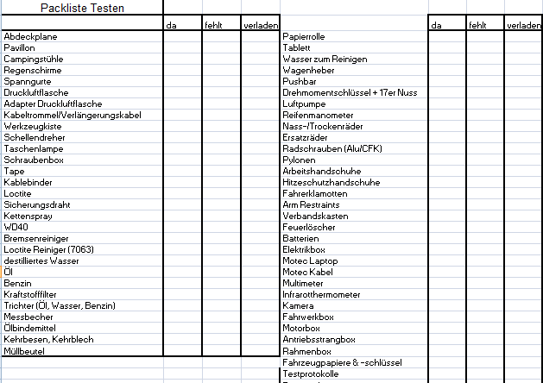
Check list for packing

Slide 17
Test equipment – must have
Basic engine sensors
Oil/water temp.
Oil pressure

Slide 18
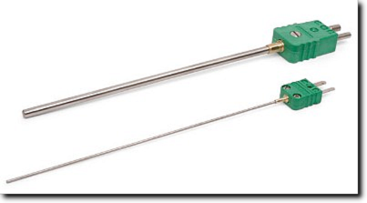
Test equipment – must have
Basic engine sensors
Oil/water temp.
Oil pressure
IR-gun with thermo couple

Slide 19
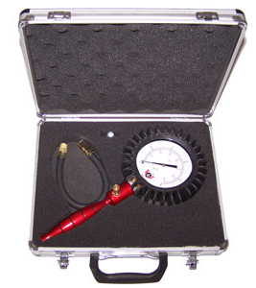
Test equipment – must have
Basic engine sensors
Oil/water temp.
Oil pressure
IR-gun with thermo couple
Manometer e.g. 0-2 bar

Slide 20
Test equipment – must have
Basic engine sensors
Oil/water temp.
Oil pressure
IR-gun with thermo couple
Manometer e.g. 0-2 bar
Stopwatch

Slide 21
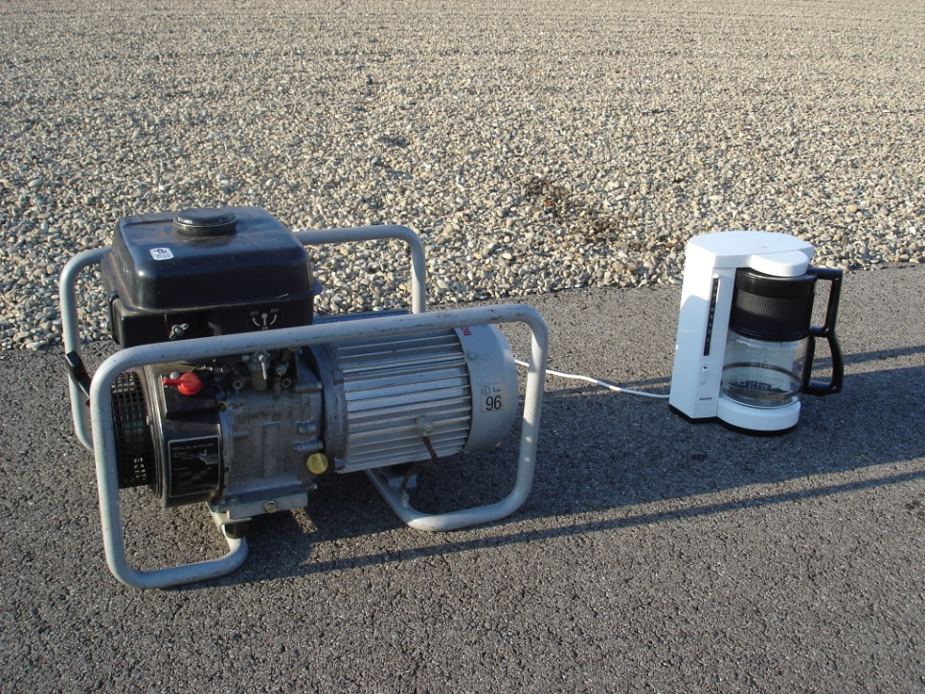
Test equipment – must have
Basic engine sensors
Oil/water temp.
Oil pressure
IR-gun with thermo couple
Manometer e.g. 0-2 bar
Stopwatch
Make sure drinks and food are available.

Slide 22
Money for testing?
Tires are the expensive part. Ca. 600€ per set
You should get min. 1 set of NEW tires. 2 are better.
Try to get used tires. For the first part of testing you could use any tire.

Slide 23
Documentation
Write the minutes!
So other team members can be up to date.
You directly have a todo list for the workshop.
If similar problems recur, you can check the cirumstances.

Slide 24
Documentation
While performance testing especially suspension parameters are important.
Write them down!
Comment them in your test log!
Than you have different setups for competition.

Slide 25
Documentation
Write a tire book.
Every tire should be marked.
Best would be to write down every heat cycle.
Watch the tire! You can learn a lot from the thread wear!

Slide 26
Safety
Especially with student built prototype cars very important!
Almost everything can happen.
Even at competition you can see flying wheels or burning cars.

Slide 27
Safety
Especially with student built prototype cars very important!
Almost everything can happen.
Even at competition you can see flying wheels or burning cars.

Slide 28
Safety
Especially with student built prototype cars very important!
Almost everything can happen.
Even at competition you can see flying wheels or burning cars.

Slide 29
Safety
...
What can you do?
Always drive with full driver protection.
Always leave a lot space between your track and obstacles.
Always have your fire extinguisher with you.
Dedicate one person as fire man.

Slide 30
Coordination
Setting off to the competition
Scrutineering
Tilt, Noise and Brake
Dynamics
Endurance

Slide 31
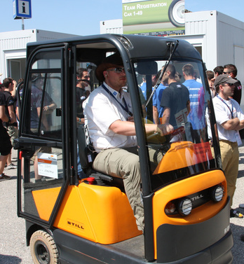
Setting off to the competition
Use testing checklist as guide
Bring all other spare parts too (sheet metal, screws,…)
Think of different szenarios
Think of how to carry all your stuff at the eventsite

Slide 32
Setting off to the competition
Bring tested tyre protection
Mount the correct tyres at home
Bring enough rims
Maybe scrub the tyres at home

Slide 33
Scrutineering
Follow the inspection sheet, test scrutineering with alumnis
Get the car scrutineering proof as soon as possible after the rollout
In doubt: Ask, change or backup

Slide 34
Tilt, Noise and Brake
Test it at home!
Bring a backup muffler

Slide 35
Dynamics
Define the 4 Dynamic Area guys for the whole event
Define the belt-on-guy for the endurance
Define the drivers in the early testing phase latest
Check, but don’t over check the car in the evening

Slide 36
Dynamics
Warm up the engine early enough
Fuel up enough
don‘t wait too long
Don‘t do panic setup changes
Ride height changes can lead to bad wheel load distribution

Slide 37
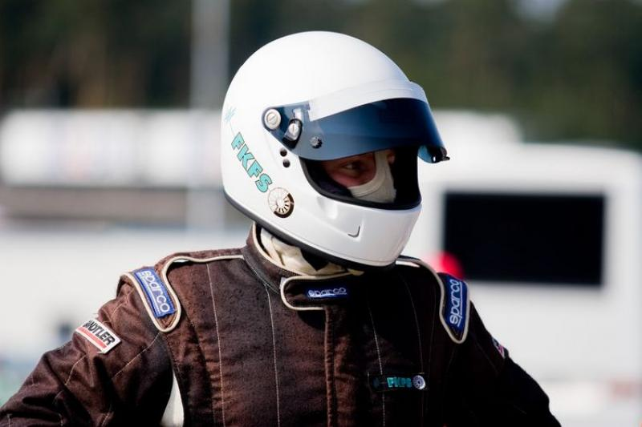
Endurance
Check damper setting and tyre pressure
Warm up the engine early enough
Fuel up early enough
Don‘t knock cones

Slide 38
Dynamics : The driver

Slide 39
How to form your own famous driver
Driver casting : Find your „driver raw material“
Driver training : Give him a shape
Testing : Effective use of your driver
Competition : Your driver needs perfect conditions to perform well
…to become YOUR famous driver ☺
Ergonomics : The drivers workplace

Slide 40
Driver casting
Driver raw material should have the following qualities:
Talent
Reliability
Willing to spend extra time (weekends!)
Be part of the team
Character: calm, sensible, no „prima donna behaviour“
How to cast?
Karting, testing with old cars…
Important: Driver decision as early as possible – 6 drivers
Notes:
Talent is not all – reliabilty is even more important!
You have to trust him – he drives the car of the WHOLE team.
Integration in the team

Slide 41
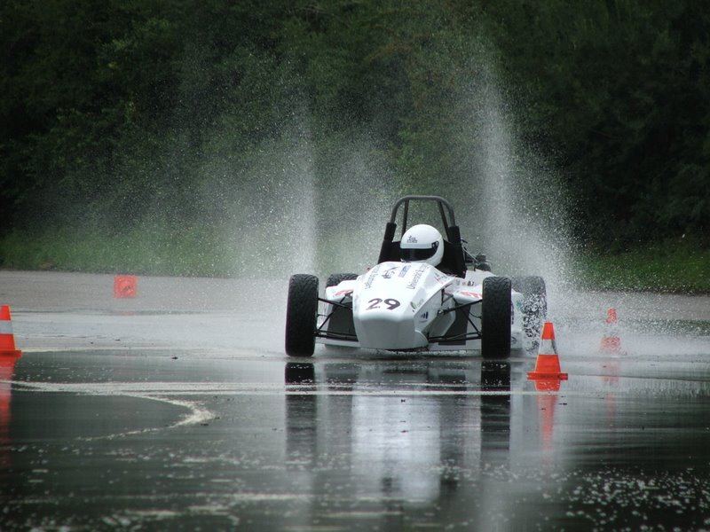
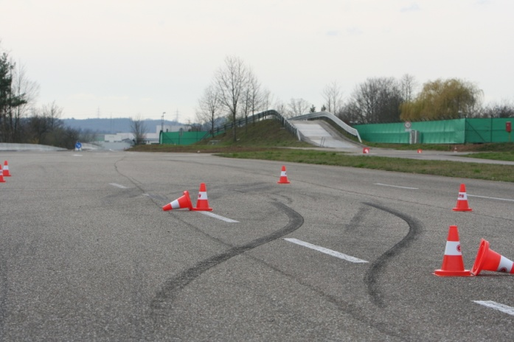
Driver training – Shaping your driver
Testing time is valuable → Only drivers are allowed to drive
First decision: Who drives which dynamic event
Get to know the car – drive, drive, drive. Don‘t hassle with performance setup!
Build tracks similar to Formula Student tracks
Use cones, mark and count them, try to avoid Off Courses
Practice dynamic events under competition conditions
Practice difficult situations – confidence for your driver
Physical fitness is important – and gives you mental fitness

Slide 42
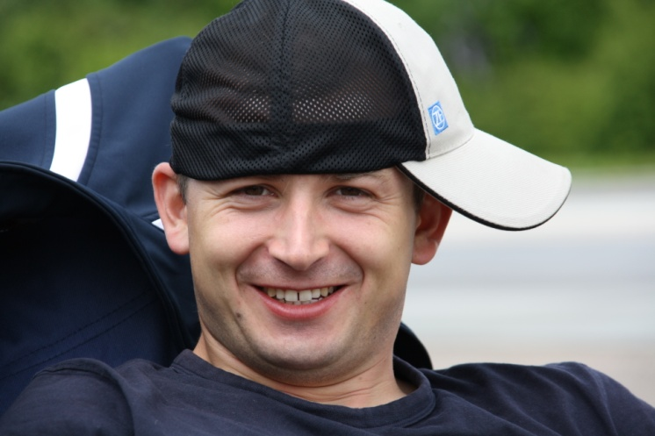
Testing – Effective use of your driver
Drivers have tiny little brains – at least as soon as they sit in the car
One dedicated person that communicates with the driver
This person – and only THIS person, tells the driver what to do
The driver can‘t see what‘s going on behind the main hoop – DANGER!
Important for performance setup testing: constant laptimes
Listen to your driver – talk to your driver
Drivers should write feedback sheets

Slide 43
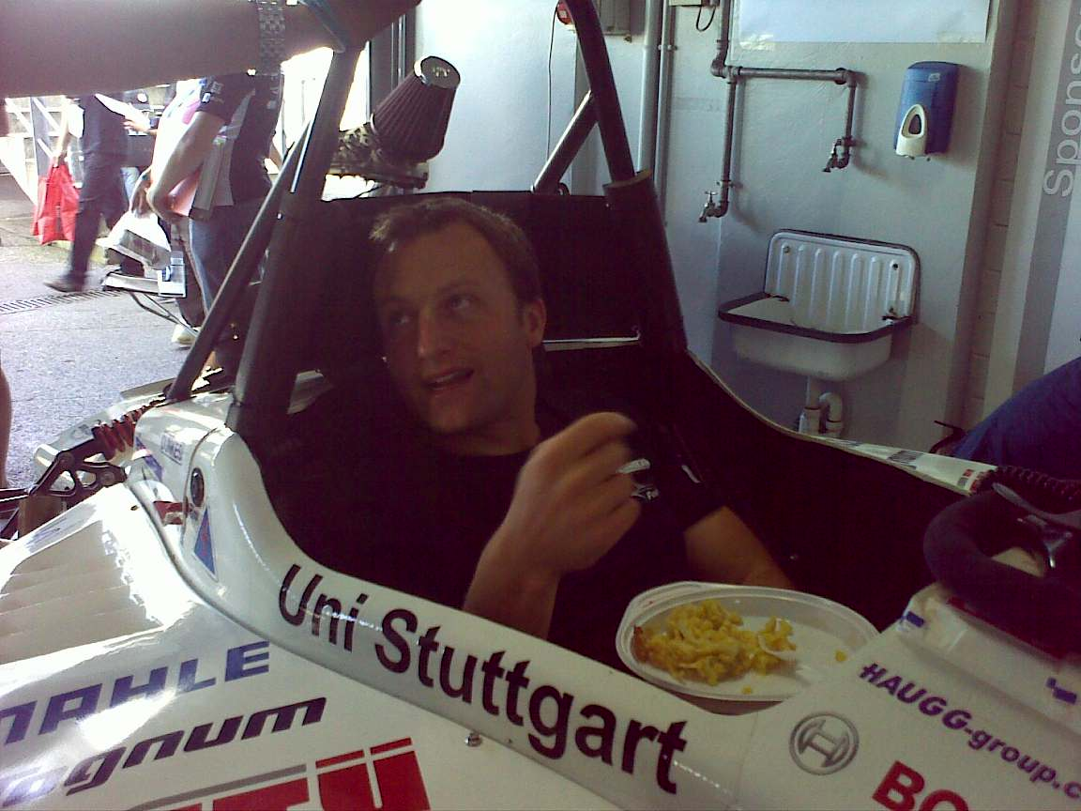
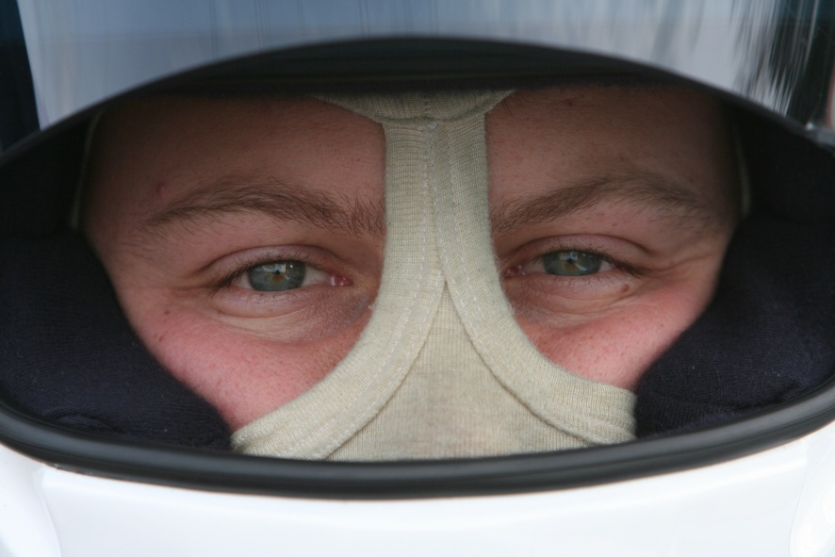
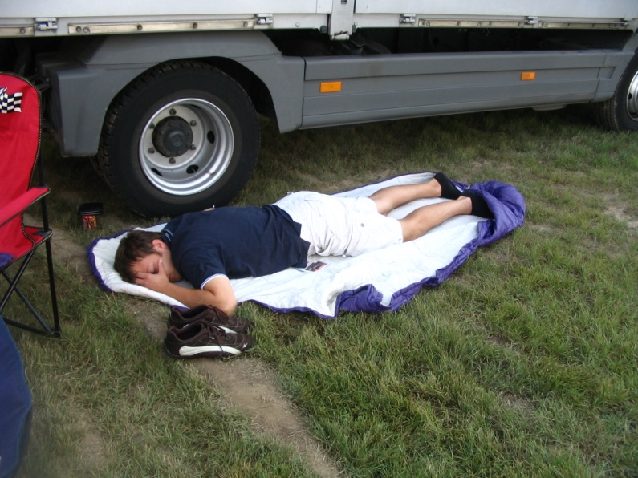
Competition dynamics – The driver is your front man
The driver‘s only task is to drive as fast as possible – and make no mistakes
Keep stress away from him on dynamic days – his focus is driving
In queue: one team member with eye contact
Driver has to trust the team – team has to trust the driver
Drivers are nervous and need to be looked after
Eat in time and drink enough
Stay calm, watch other cars, take a nap …
Don‘t sit in the car for hours (in the sun)

Slide 44
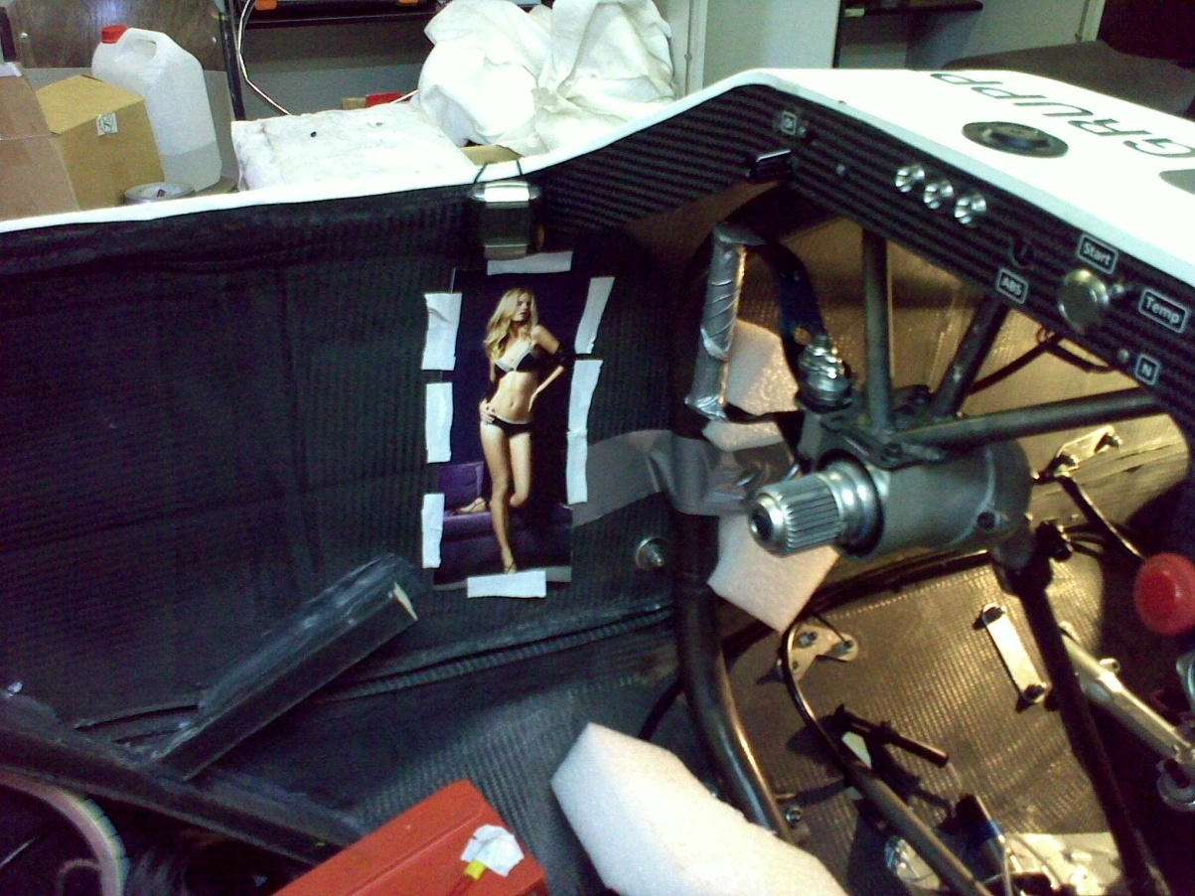
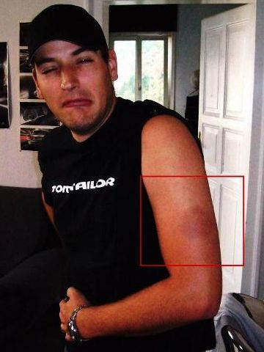
Ergonomics – The drivers workplace
My car is my castle – feeling comfortable helps a driver go fast
Build the car around the driver
Think about different drivers
Seat : should give precise feedback what the car is doing
Steering forces : don‘t underestimate them
Driver should not look like this →

Slide 45
See you at Hockenheim
August 2010

